Slide 1

Streaming Insights Analyzing OTT Data Trends
Jasmine Emmanuel Lekshmi Venu
Rolls John

Slide 2
Contents
Introduction
Business value
Problem Statement
Pipeline
Findings
Results

Slide 3
Introduction
OTT" stands for Over-the-Top and refers to the delivery of video, audio, and other media content over the internet, bypassing traditional distribution methods like cable or satellite TV.
Content Analytics :OTT platforms analyze data related to content performance, including viewer ratings, viewer retention, popular genres, trending content, and the success of original productions.
Recommendation Systems: OTT platforms leverage data to create recommendation algorithms that suggest content tailored to individual user preferences.

Slide 4
Business values
Enhanced User Experience
Content Optimization
Revenue Generation
Improved Customer Acquisition and Retention

Slide 5
Problem Statement
Retrieve all required data from source-Extraction
Transformation-Data cleaning and aggregation that prepares it for analysis
Loading-Extracted and transformed data is loaded into the end target.

Slide 6
Data Analysis - Load the dataset for analysis
- Perform cleaning and handle the outliers.
- Perform required transformations
Data Visualization – Understand patterns
- Communicate information
- Explore data
- Make Informed decisions

Slide 7

Pipeline
Ingestion
ETL
Data Science
Machine Learning
Batch
Business Intelligence
Analytics
Data Source
Raw data
Curated
Data Consumer

Slide 8

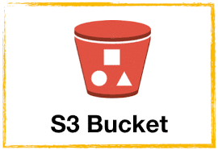




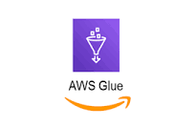


Raw Data
Curated Data
Visualization
Ingestion
Transformation
Batch data
Glue Crawler
Analysis
S3 trigger
Glue Catalog
Athena

Slide 9
Results

Slide 10
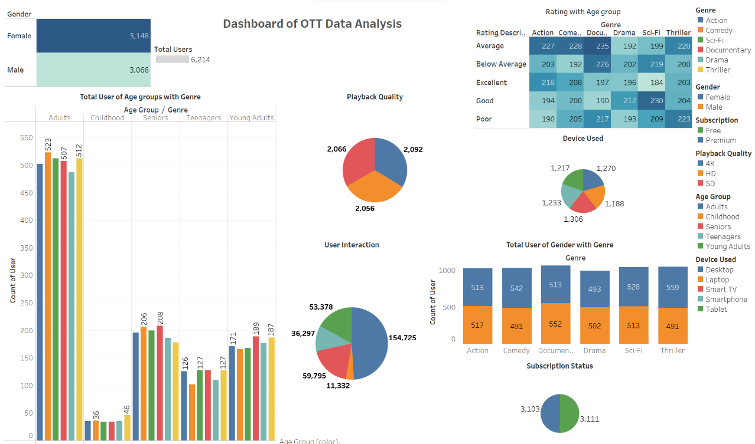
Dashboard of OTT Data Analysis

Slide 11
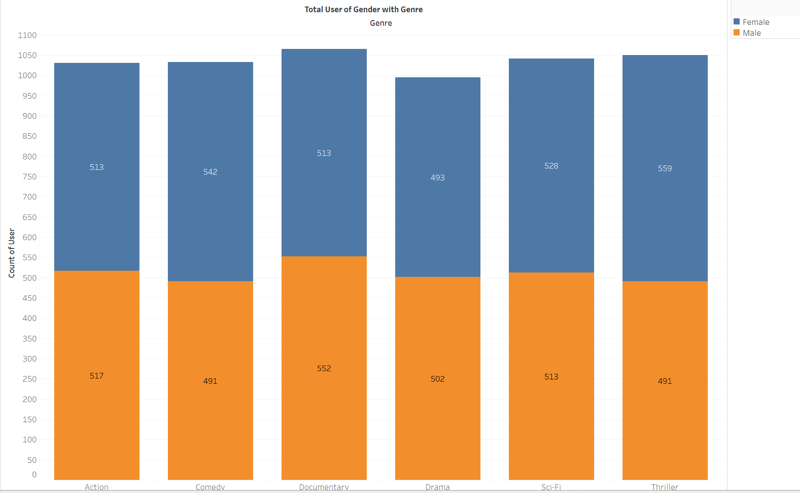
Analyse User with Gender

Slide 12
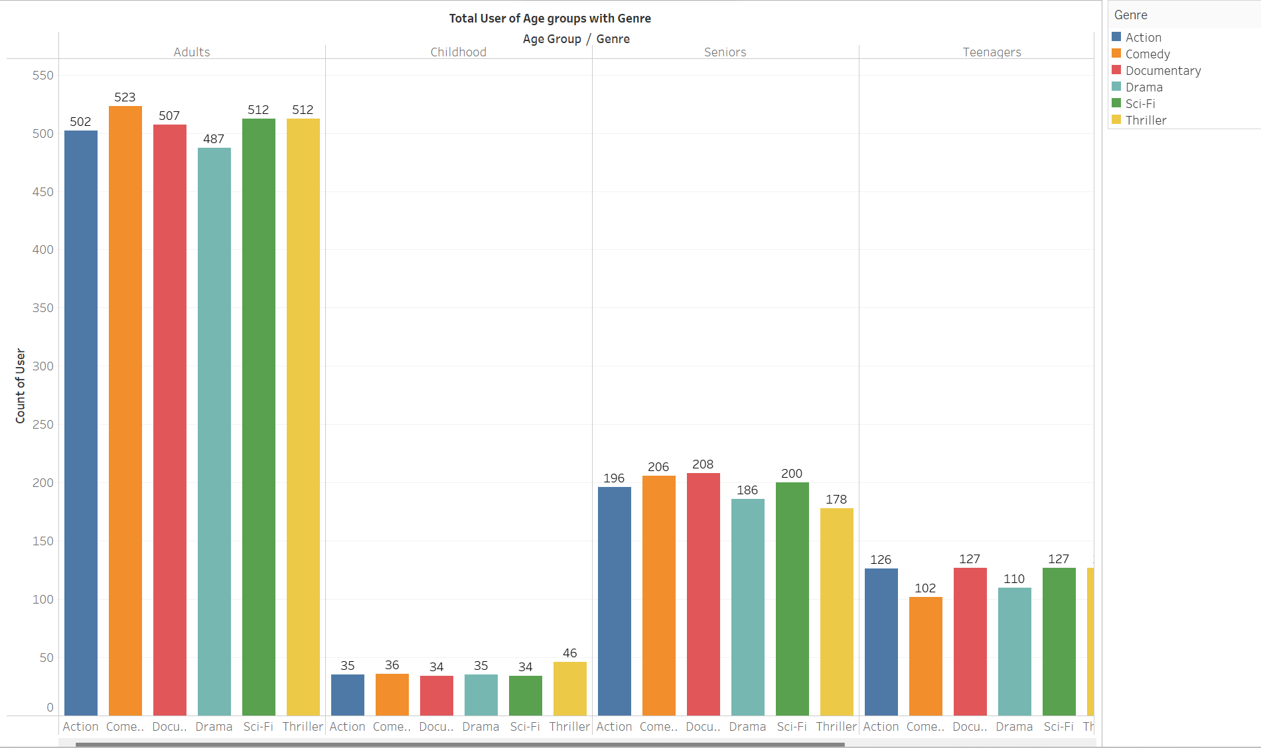
Analyse users under different age group with Genre of Video

Slide 13
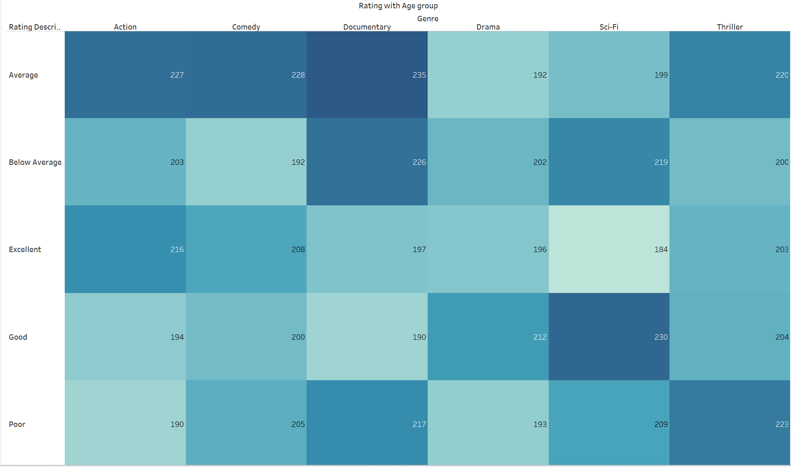
Rating of Ott platform with different age group users

Slide 14
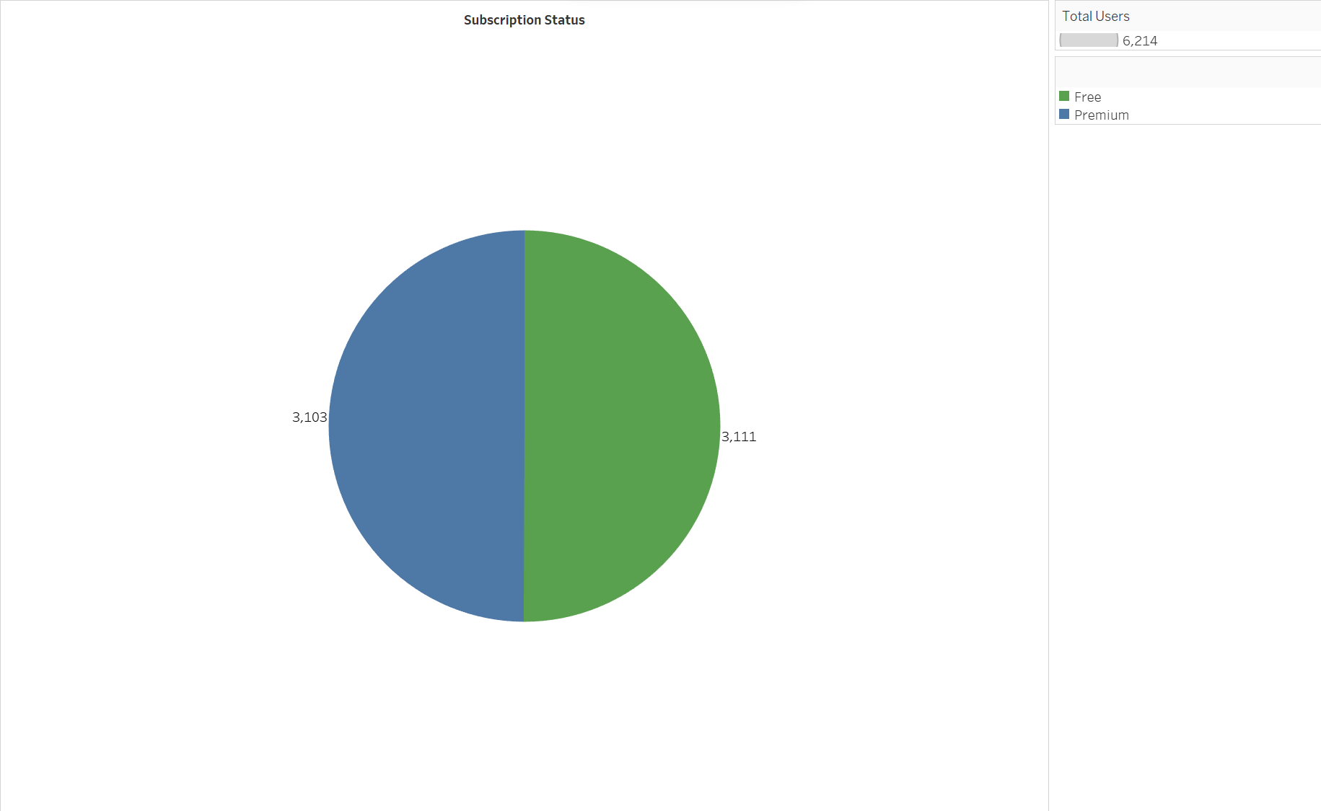
subscription status

Slide 15
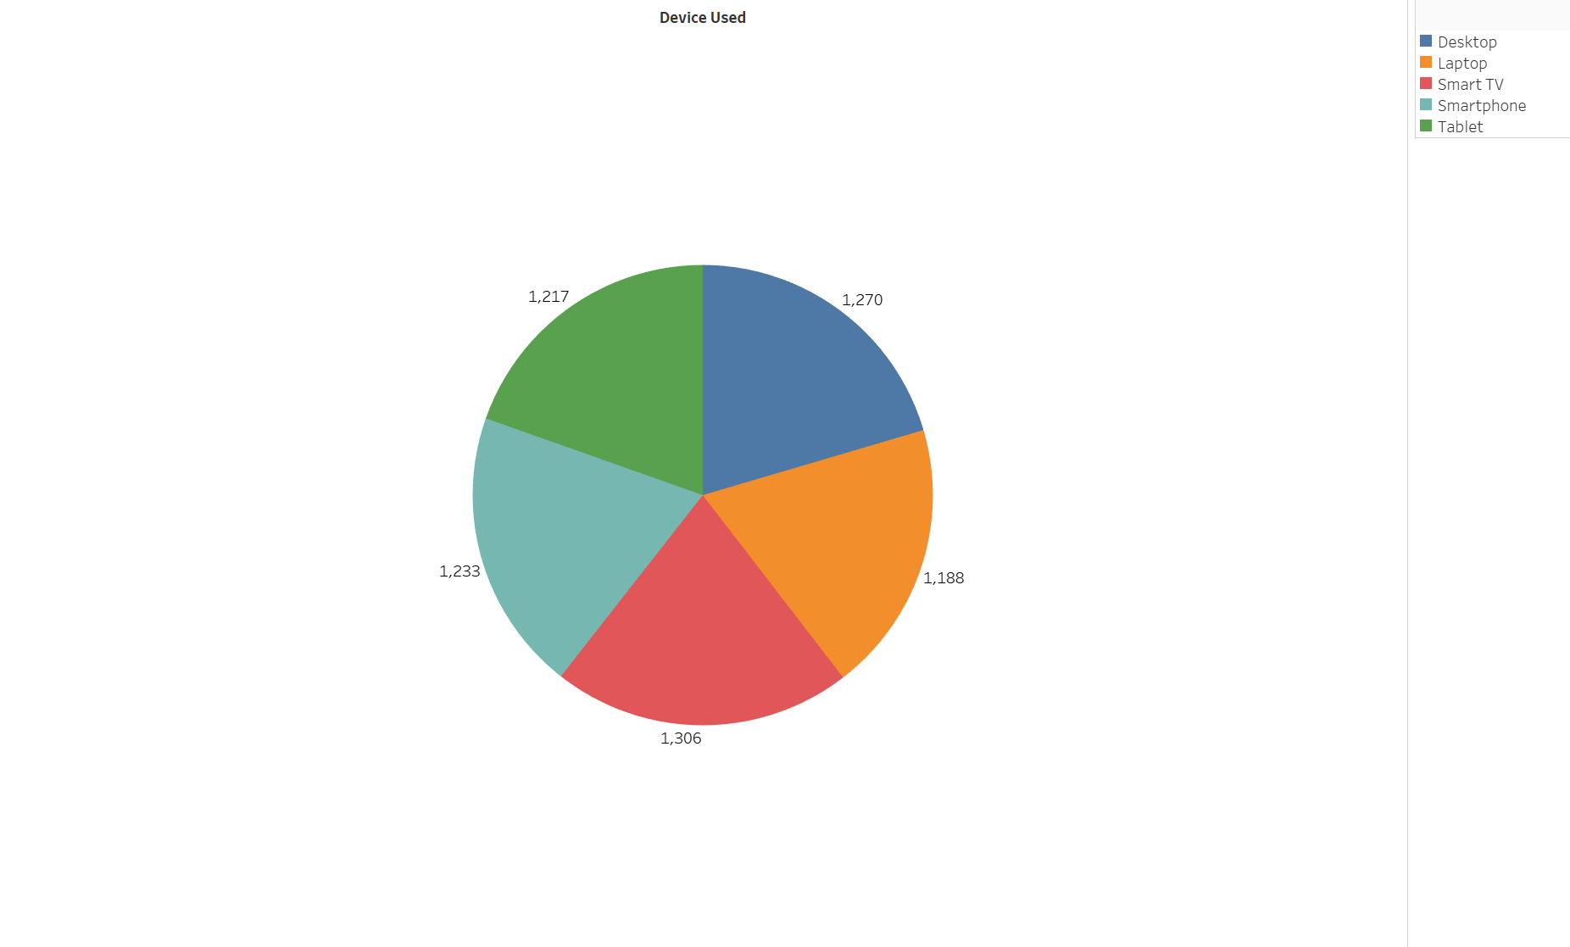
Analyse the devices used

Slide 16
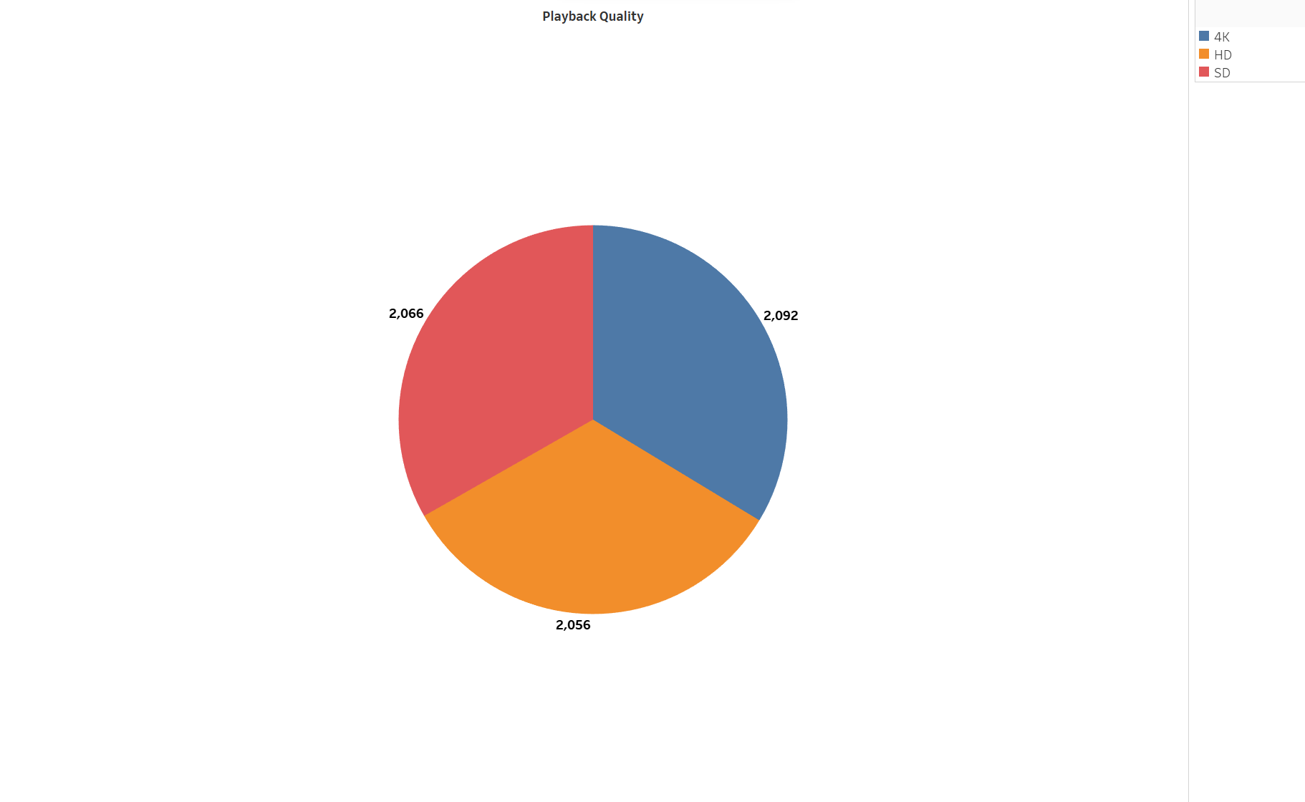
Quality of video

Slide 17
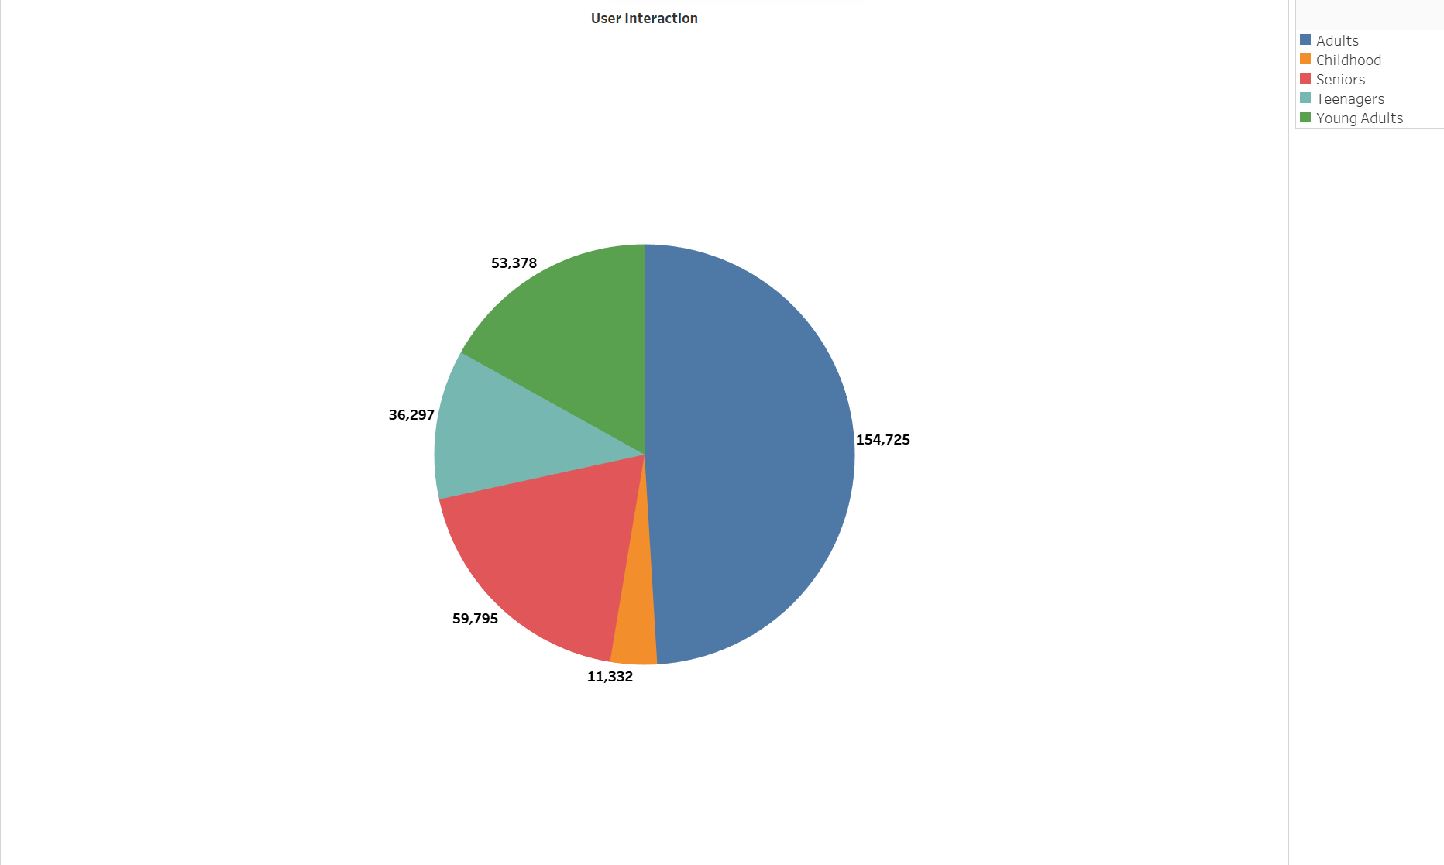
Analyse the interaction of users with different Age group

Slide 18

Future Work
Sagemaker:
AWS has an AI modelling tool which we can use to create, train and deploy machine learning models. This will allow us to predict future trends.

Slide 19
Thank You

